Slide 1
Successes & Next Steps

Slide 2
Why is this work critical?
“Fully addressing social determinants of health requires a shift in power that enables marginalized communities to co-design their own healthcare solutions. Unfortunately, health insurers, while willing to alter payment models and entertain some changes in what they will pay for, have yet to grasp the more fundamental nature of the need for system change and community empowerment inherent in the idea that health, ultimately, is about much, much more than health care.”
American Journal of Managed Care, 2/15/18

Slide 3
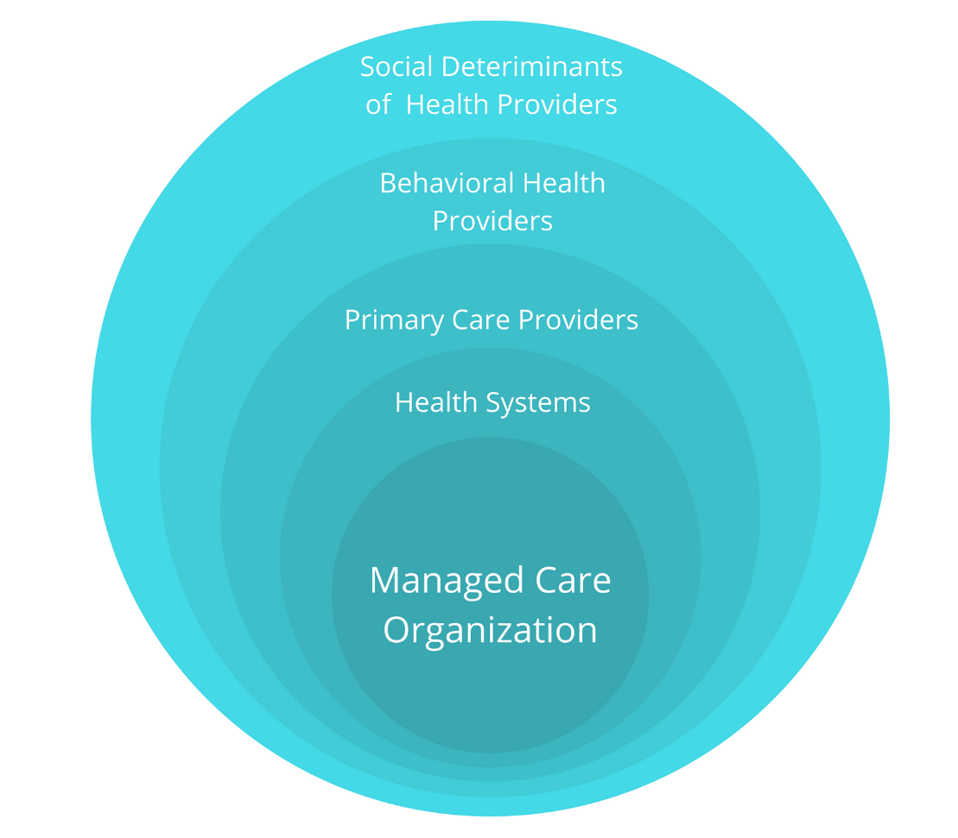
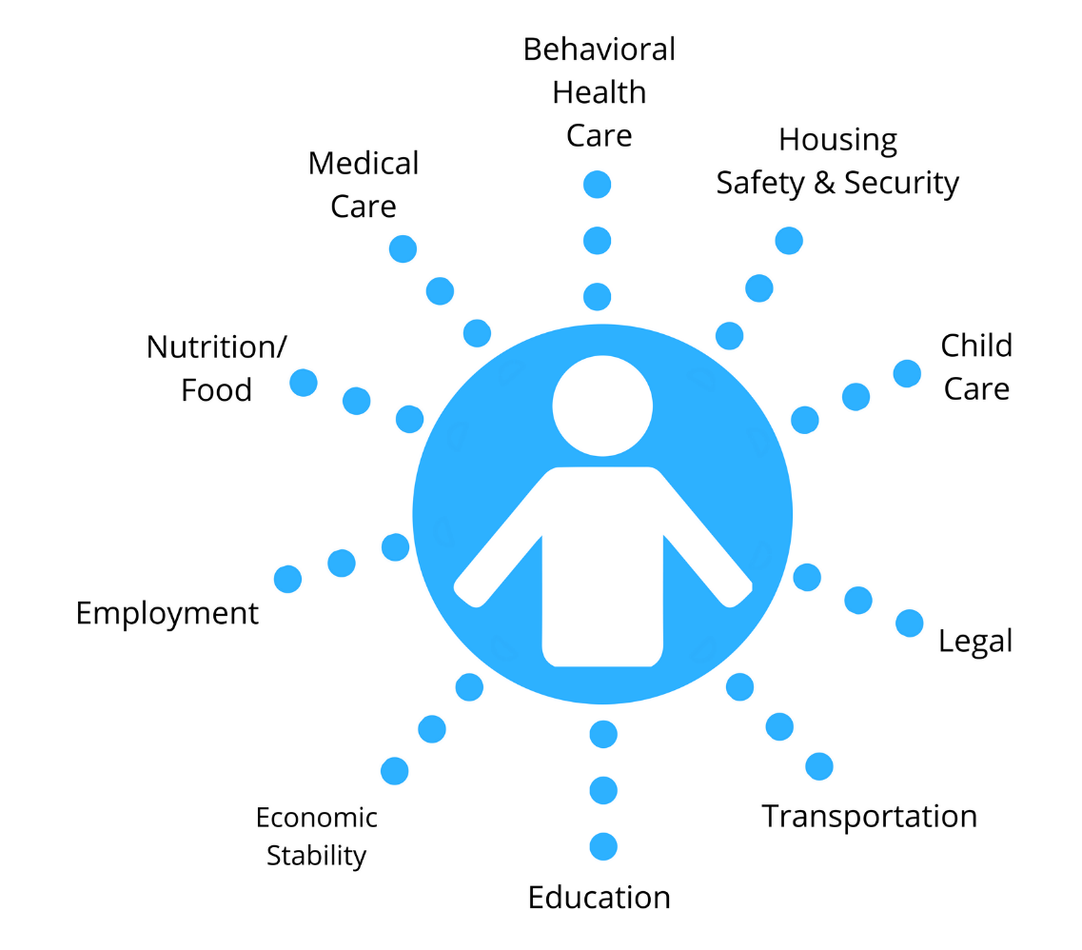
Why a health equity focus?
Value Based Payment Arrangement
Client Focused Service Delivery Model

Slide 4
Question
Did DSRIP result in improved patient/client care?
Results
Yes: 76%
No: 24%

Slide 5
Question
Has there been a shift in understanding of the impact of the Social Determinants of Health on patient care since DSRIP?
Results
Yes: 93%
No: 7%

Slide 6
HEALI Collective Mission
To engage health and human service agencies, community members and other stakeholders to ensure equitable health and life outcomes for all Long Islanders through cross-sector partnerships, innovative funding strategies and improvements in the health & human service delivery system. We will use our collective power to influence public policy and investment decisions by funders.
Notes:
Original 1115 Waiver. $2.5 million CBO Planning grant that provided honorarium for participation

Slide 7
HEALI Collective Vision
To build and provide an integrated, holistic, culturally and linguistically responsive health and human service delivery system that results in equitable health and life outcomes for all Long Islanders.

Slide 8
Goals
Develop an IT infrastructure that allows for multi-directional data sharing among agencies, while respecting clients’ rights and protecting their privacy.
Improve connectivity between agencies as they screen clients and track referrals within the sector.
Engage community members, being inclusive and using a culturally and linguistically competent lens.
Use our collective power and unified voice to advocate for services and investments needed for Long Island’s diverse communities.
Develop strategies that simultaneously prepare CBOs for change, convey value and highlight our leadership and expertise to collectively impact a transforming healthcare system.

Slide 9
Question
Which social determinants of health played the significant roles in health outcomes for our clients during COVID? (check all that apply)
Results
Access to internet/technology. 70%
Housing. 82%
Access to food. 67%
Job security. 45%
Job flexibility to work remotely. 57%
Childcare. 67%
Access to healthcare. 76%
Transportation. 45%
Language access. 56%

Slide 10
Question
While COVID unearthed significant inequities, as providers we also learned a new way of providing services. What became possible that we didn’t think was possible? (check all that apply)
Utilization of remote social care.
Utilization of telehealth.
Appreciation for how social determinants of health impact people’s health and life outcomes.
Increased services and supports to address the social determinants of health.
Increase in service integration and referral.
New social supports and programs.

Slide 11
Results
Utilization of remote social care.
74%
Utilization of telehealth.
77%
Appreciation for how social determinants of health impact people’s health and life outcomes.
57%
Increased services and supports to address the social determinants of health.
45%
Increase in service integration and referral.
45%
New social supports and programs.
66%

Slide 12
1115 Waiver Demonstration Conceptual Framework
2
Purpose: Five-Year 1115 Waiver Demonstration
Goals:
Address health disparities and systemic health care delivery issues that have been highlighted and intensified by the COVID-19 pandemic,
Stabilize and transform New York’s safety net,
Promote community-based and non-institutional care,
Better integrate health care and social care,
Leverage emerging technologies and care models, and
Ensure readiness for future health care emergencies

Slide 13
1115 Waiver Demonstration Conceptual Framework
$12-17 Billion Request
Social Determinant of Health Networks
VBP arrangements
Supportive housing projects
Safety Net Hospitals
HERO regional governing bodies
Notes:
Positive
Recognition of equity and impact of COVID.
Increased transparency and communication.
Recognition of need to address multiple social determinants of health.
Role for Social Determinant of Health Networks.
Elimination of PPS entities.
Concern: Role of Managed Care Organizations

Slide 14
Opportunities for HEALI
Strengthen and expand HEALI Coalition.
Strengthen service integration and referral.
Further build out NOWPOW service directory and utilization.
Identify current needs and ways to address them.

Slide 15
Next Steps?
Expand HEALI partnership.
Identify a care model based on new needs and current agency capacity.
Build out NOWPOW service directory and utilization for referral.
Build out an advocacy agenda to educate NYSDOH on Long Island and other key stakeholders.

